Slide 1


Slide 2
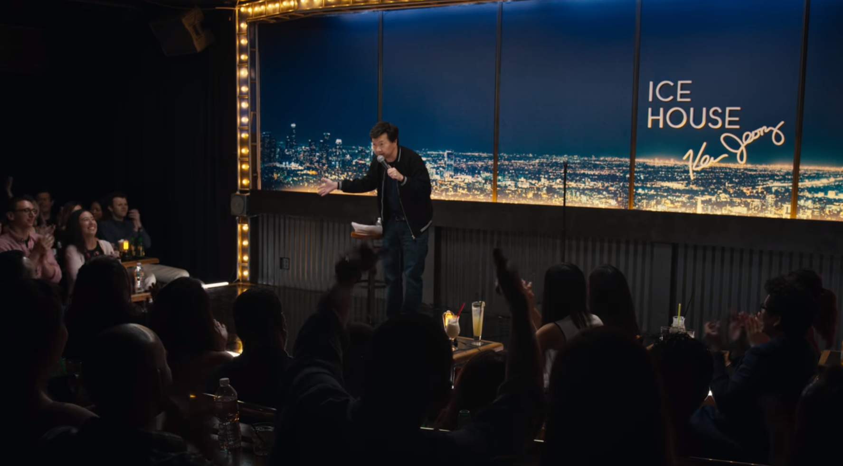
You Complete Me HO!
Ken Jeong

